Slide 1

Welcome to SSJ 302 Python Programming &
SSJ 30274 Computer PROG for GIS
Instructor: Yanan Wu

Slide 2
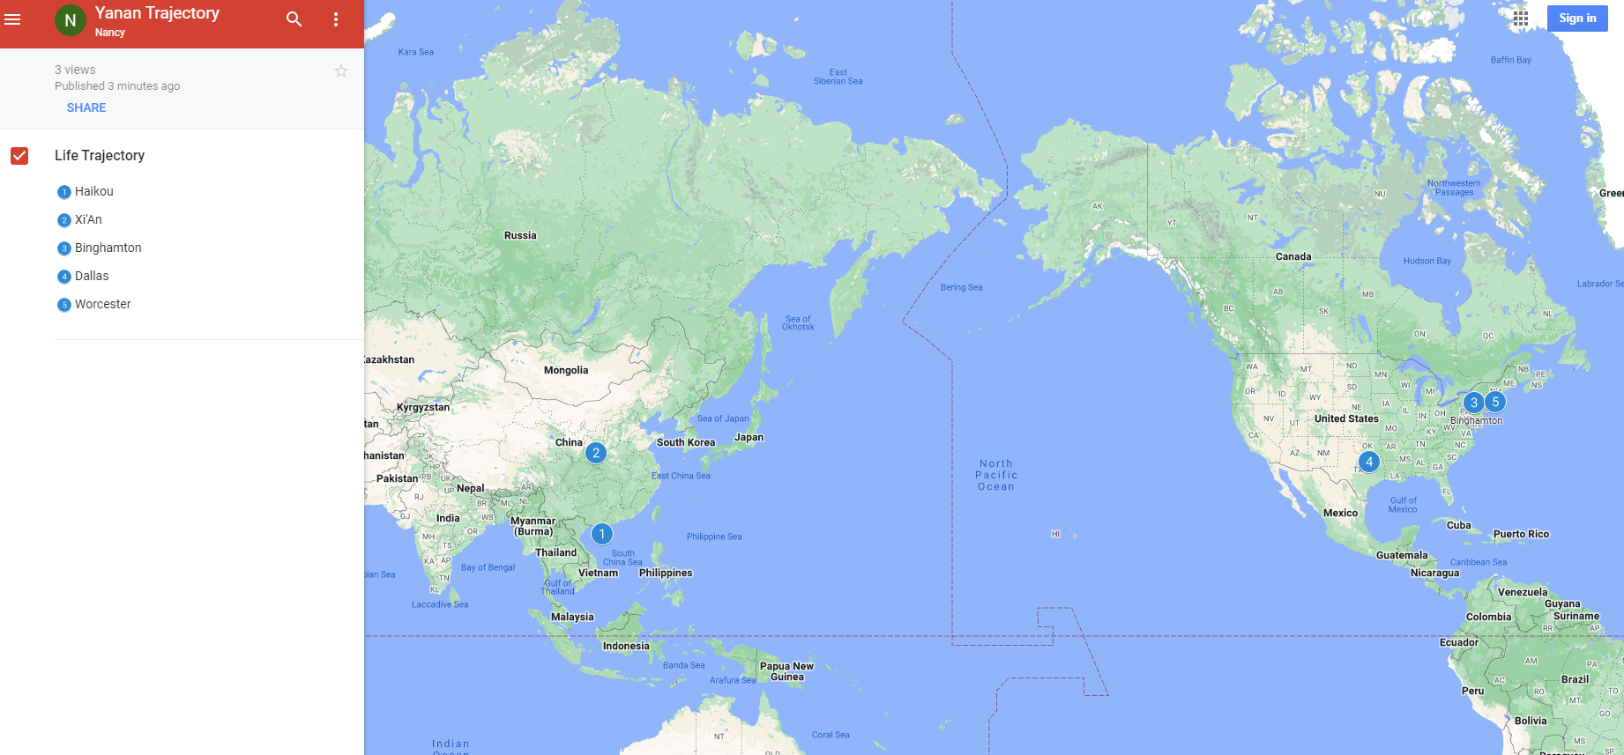
Yanan Wu – Visiting Assistant Professor
Education & Experience

Slide 3


Teaching
Python Programming &
Computer PROG for GIS
Web Mapping & Open Source GIS
Manipulating Spatial Data
Web Mapping
Processing Raster
Data Analysis
Creating Custom Tool
Data Visualization
…
GitHub
HTML & CSS
JavaScript
Python
R
ArcGIS Online
…

Slide 4
TA Introduction
Shradha Birdika
Majored in Geography, Minored in Economics
First honors on the Clark University Dean's List

Slide 5
How about you?
Your background (e.g., name, major, where you come from)
What is your funniest thing that happened during your summer break?
What relevant experience do you have with python?
What are your expectations for this course?

Slide 6
Please Register two modules
SSJ 302 Python Programming
SSJ 30274 Computer PROG for GIS

Slide 7
Course Format
Lectures: Physics/Math, 3rd Floor, Room 310
Monday: 12:00 – 1:15 PM
Wednesday: 11:00 – 11:50 AM
Labs: Physics/Math, 3rd Floor, Room 310
Wednesday: 12:00 PM – 1:15 PM
Office Hours: Monday & Wednesday: 2:00 – 3:00 PM (or by appointment)
Office Location: Geography Main Office, Jeff 220

Slide 8

Course Schedule
Week 7 (Oct 7)
Review Topic about Midterm on Monday
Midterm on Wednesday (TBD: Topic and format)
Week 15 (Dec 2)
Final Presentation Due
Week 16 (Dec 9)
Final Project Due
*schedule for other weeks please see syllabus

Slide 9
Course Requirements
Labs: 11 in total.
For any graded assignment, if the you do not agree with the grade received, the
instructor must be notified within one week after the assignment is graded.
Late policy for lab (excluding midterm and final project)
One midterm exam & One Final Project (Oral presentation and paper report)

Slide 10
Extra Credit
The instructor reserves 30 extra credit points (3% of total grade) for those students who actively respond to the questions from other students posted on Discussion Forum.
The instructor will strive to respond to questions within two business day, i.e., 48 hours excluding weekends.

Slide 11
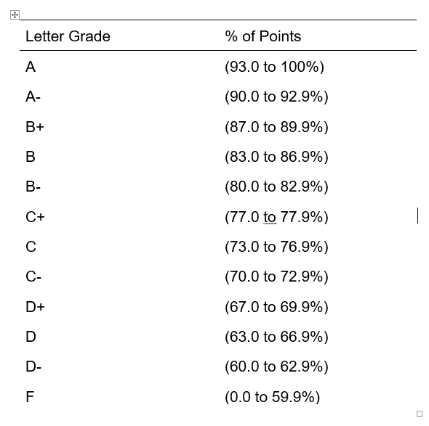
Grade
11 lab (70%): 700 points (70%)
Midterm exam (15%): 150 points (15%)
Final Project (15%) 150 points (15%)
1000 points total (100%)
Extra credit (3%) 30 Points

Slide 12
Textbook
Free Online learning source
Ujaval Gandhi (2024). Python Foundation for Spatial Analysis. https://courses.spatialthoughts.com/python-foundation.html
Dave Whipp (2023). Geo-Python 2023. https://geo-python-site.readthedocs.io
Qiusheng Wu (2023). Earth Engine and Geemap: Geospatial Data Science with Python. https://book.geemap.org
Non-open Source Textbook
Eric Pimpler, Programming ArcGIS Pro with Python, 2nd Edition

Slide 13
Emailing the TA and Instructor
Use “SSJ-Python” as the subject of the email

Slide 14
Why taking this class?
Our focus is on problem solving
Two module together
Exercise/project-oriented, not theory-oriented
We take care of what and how but not why!

Slide 15
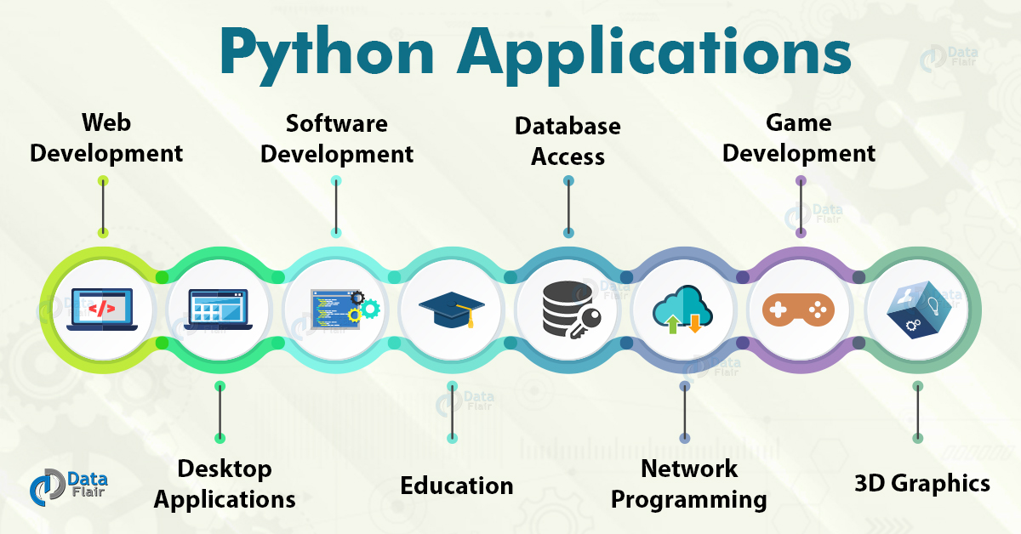
Overview

Slide 16
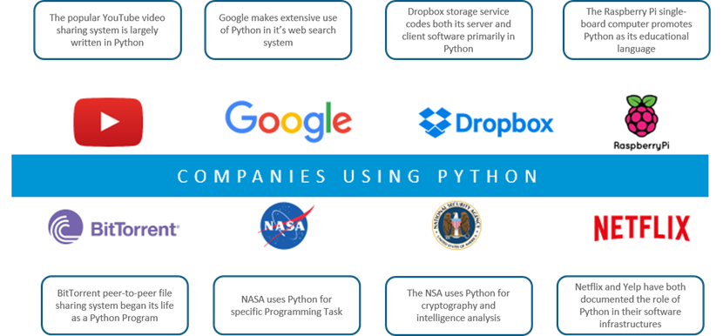

Slide 17
Why Programming?
Customize applications and tools
Reduce repetitive work
Access more functionality
Add new functionality / Extend GIS functionality into non-GIS applications

Slide 18
Why Python?
An open-source language
Packages, libraries, functions, resources…ALL FREE (Our textbooks have free versions as well)
GREAT documentation!
https://docs.python.org/3/
ArcPy (Not usable separately)
PyQGIS
Cross-platform

Slide 19
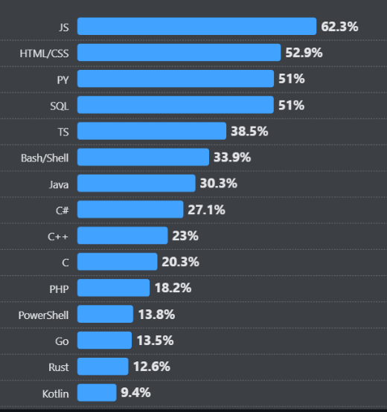
Source: survey.stackoverflow.co

Slide 20
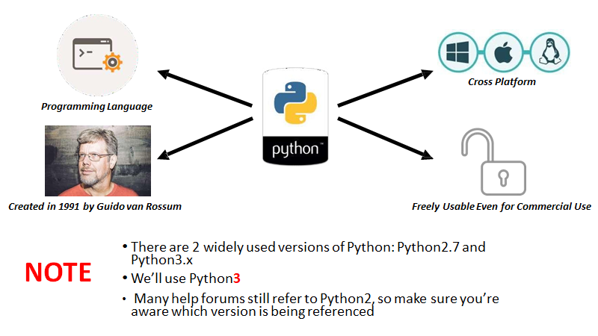

Slide 21
Python Version
Python versions
2.x up to 2.7, 3.x (currently 3.12.x)
Python 2.x is legacy, Python 3.x is the present and future of the language
3.x may have compatibility issue with other software
Be careful when you download different versions
Especially when you install external libraries and packages

Slide 22
One way to know the version of Python!
Command Prompt
Why this is important?
Different libraries
Functionality
Version reliability

Slide 23
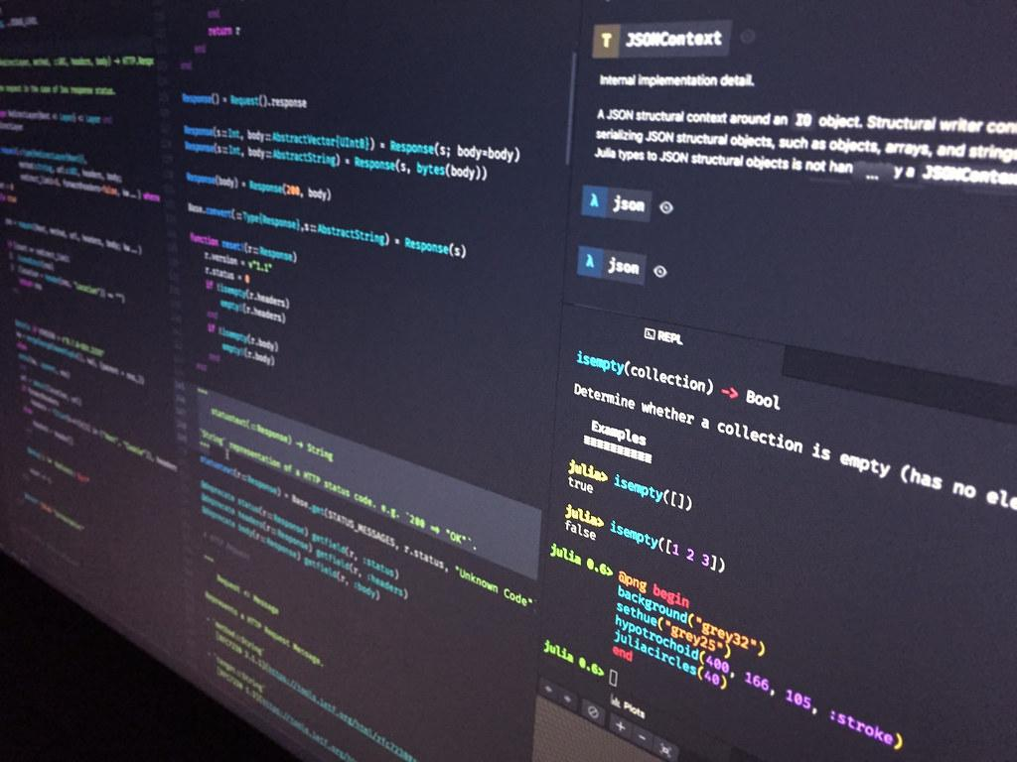
What if I do not want to deal with the command prompt?

Slide 24
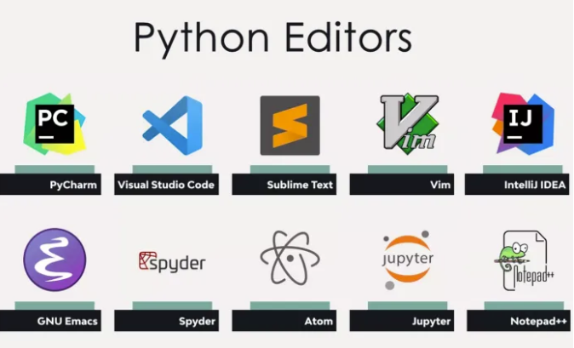
You can have both ways of writing python in most of text editors!
Source

Slide 25
Visual Studio Code (VS code)
Developed by Microsoft for Windows, Linux, macOS
Used with a variety of programming languages: Python, Java, JavaScript, C++
Various features: debugging, syntax highlighting, intelligent code completion, version control with Git
Download Link

Slide 26

How Do I Program In Python?
ANACONDA
An open-source Python distribution platform (Download link)
Manages packages and working environments

Slide 27

Google Colab
What we covered so far was based on the fact that you want to use your own computer as a Python interpreter!
What if I want to practice programming on the web?
Google Colab
Github (Not recommended for now!)

Slide 28
While Using Colab
A folder will be created automatically in your Google Drive

Slide 29
Python Fundamental
Python
Condition Statement
If, elif, else
Loops
For, while
Functions
Define, Return, Lambda
Data Structure
List, Tuples, Dictionaries, Strings
Modules and Packages
Import, Virtual Environment

Slide 30






Non-spatial data processing: Pandas
DataFrame Creation
Data Inspection
Data Selection
Data Cleaning
Data Manipulation

Slide 31
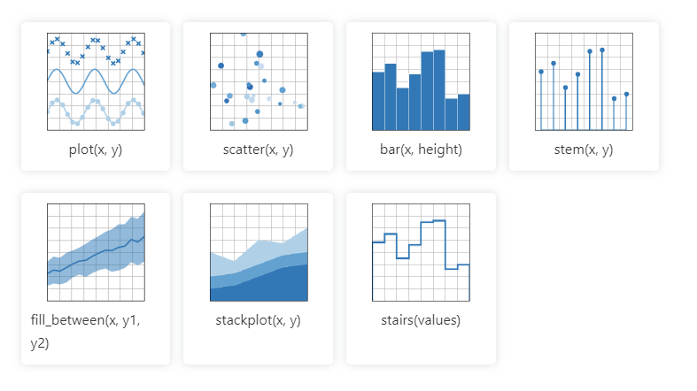
Data Visualization: Matplotlib
Matplotlib cheatsheets and handouts

Slide 32
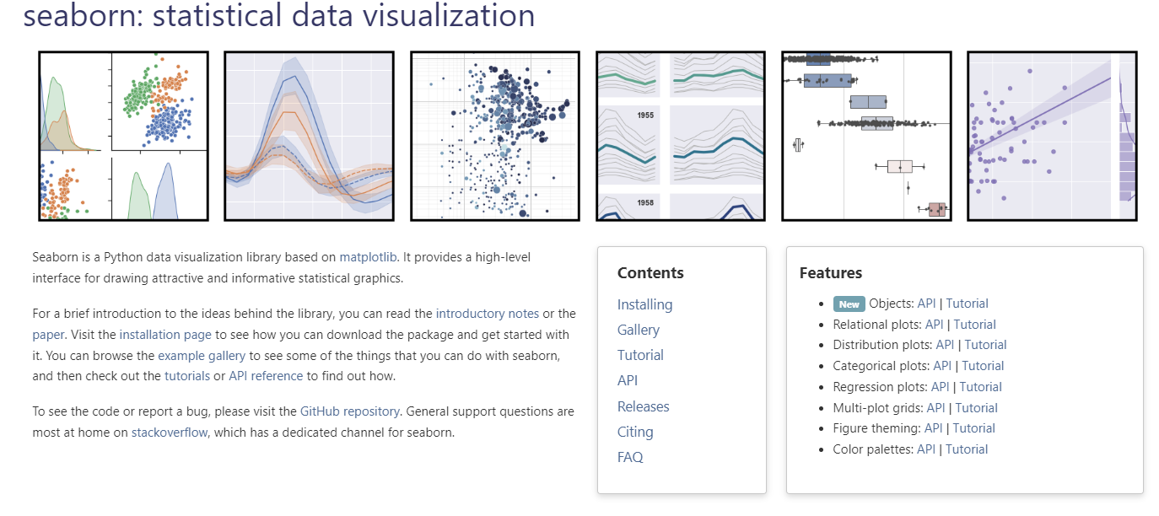
Data Visualization: seaborn
Seaborn cheatsheets and handouts

Slide 33
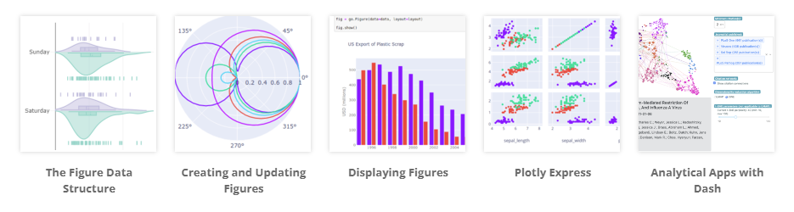
Data Visualization: plotly

Slide 34
Difference among three
plotly
seaborn
matplotlib
matplotlib: Low-level library
seaborn: built on top of matplotlib
plotly: focused on interactive plots

Slide 35
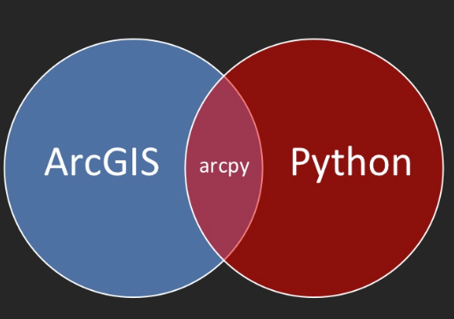
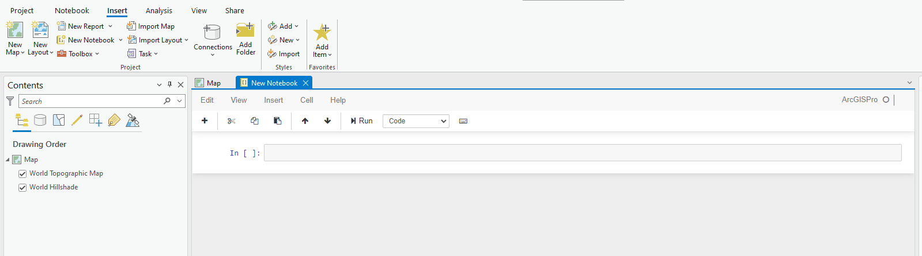

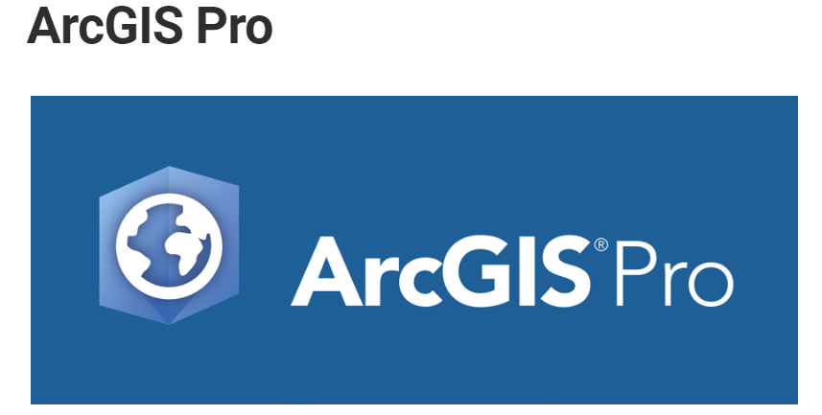
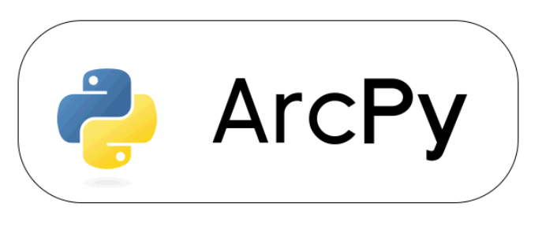
Geoprocessing - Arcpy
Integration with ArcGIS Pro
Scripting & Automation
Access to Geoprocessing Tools
Interact with other Esri products

Slide 36
Web maps using the ArcGIS API for Python
Esri User Document
Esri official Repo on GitHub

Slide 37
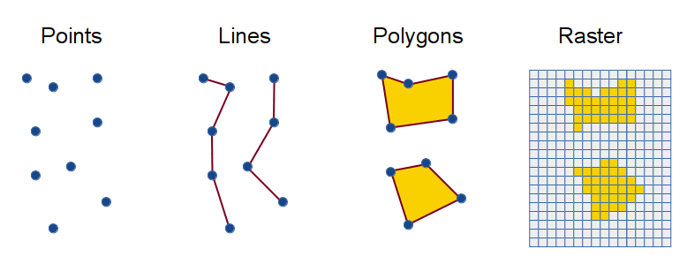
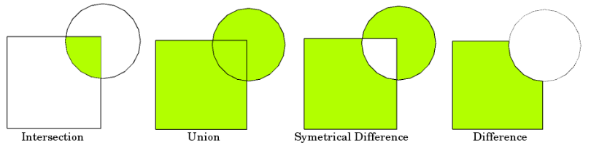
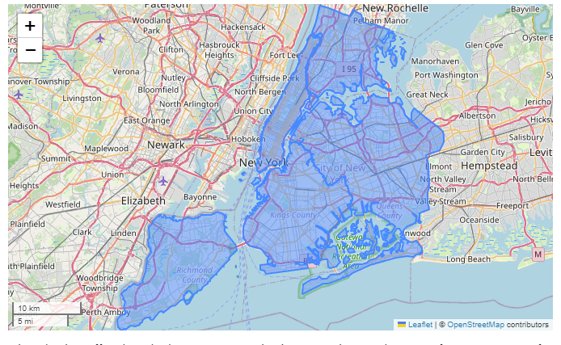
Web maps using the Open Source Spatial Libraries
Spatial Data Structure
Geometric Operation
Interactive map
Open Source
Installing with Anaconda/conda

Slide 38
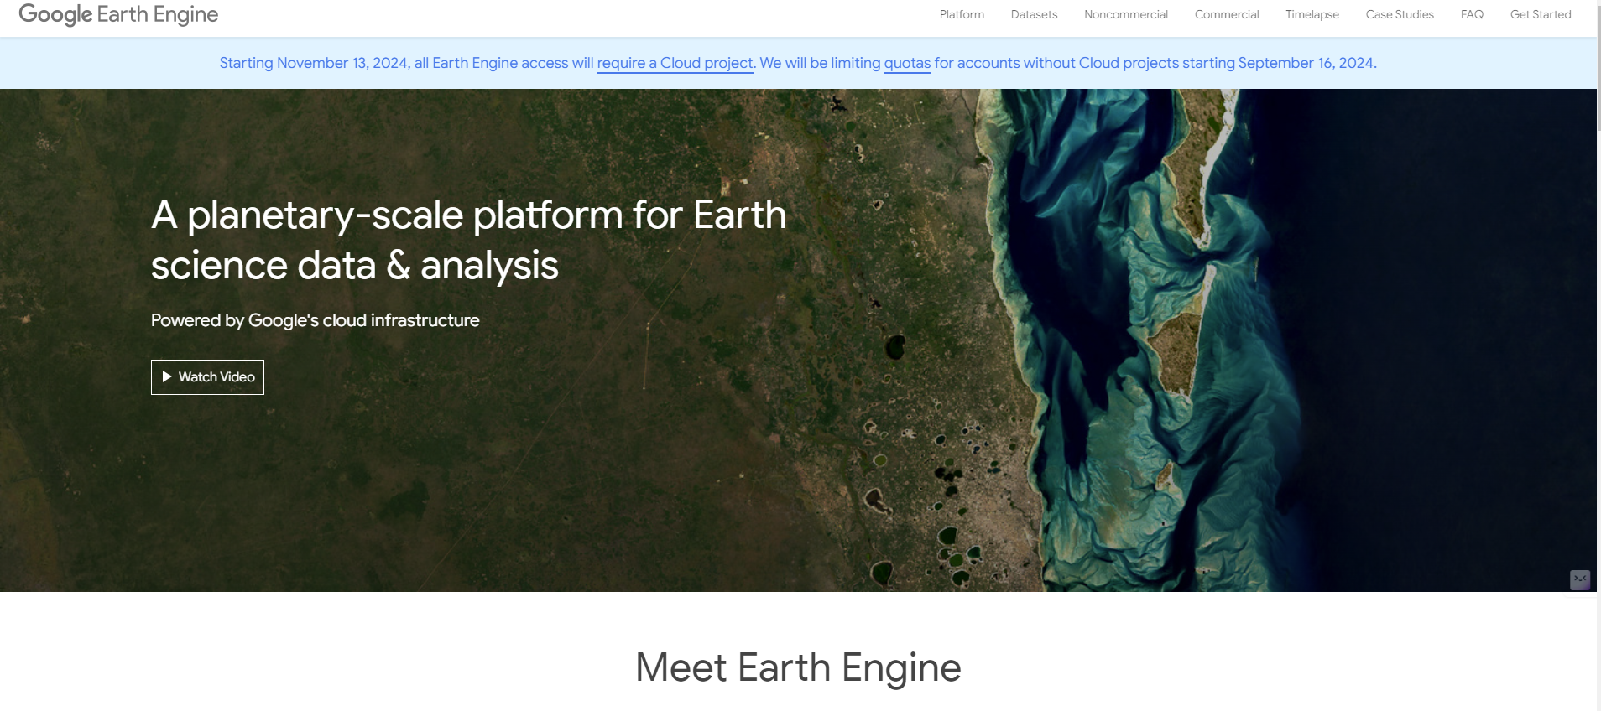
geemap – Google Earth Engine Python API

Slide 39
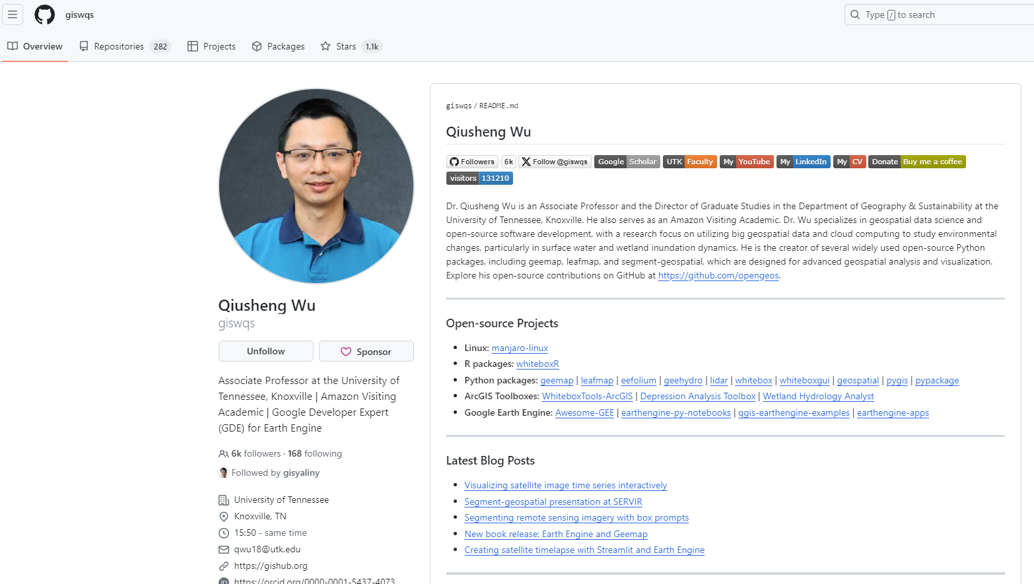
geemap – Google Earth Engine Python API

Slide 40
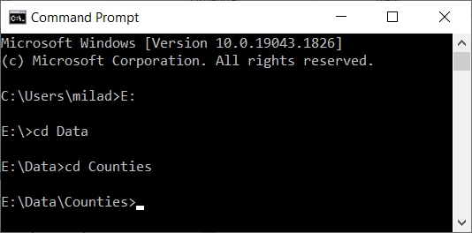
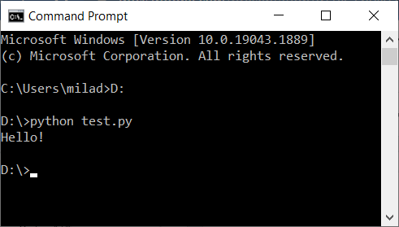
How Do I Program In Python?
Two Main Ways (You should add python to the system variable):
Normal mode (Script Mode)
Write your code in a file (it could be any type of file:txt,word) and save it with the .py extension
Execute the file by using the shell (terminal, CMD, Command Prompt): The picture on the right
You need to direct the shell to where you have the code saved:
If the file (your code) is stored directly in a Drive (in my case it is saved in D drive) you will use the following command: D:
If the file is stored in a nested folder (e.g., “E:\Data\Counties”) then you need to use the cd command: The picture on the left

Slide 41
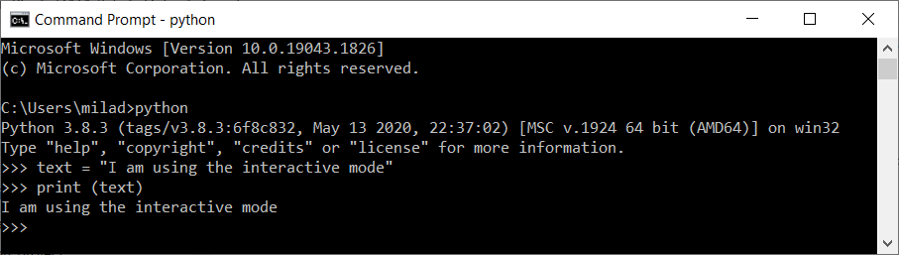
How Do I Program In Python?
The other way:
Interactive mode (interacting directly with the interpreter)
Bring up a terminal (command prompt, shell)
Type python
After the info about the version the cursor will transform to >>>
Start writing your code
After each time you press Enter on your keyboard the command line goes to the next line and if there is something to be executed it will be executed:

Slide 42
Interactive Mode
Start writing in the python interpreter of your chosen python editor.
Pay attention to the indentation
>>> the_world_is_flat = True
>>> if the_world_is_flat:
... print("Be careful not to fall off!")
...
Be careful not to fall off!

Slide 43
Course Material on GitHub
https://gisynw.github.io/ssj-302/

Slide 44
Conclusion
Class Schedule
Topics for this course
Command prompt

Slide 45
Next
Install Visual Studio Code
Install Anaconda
Set up environment in VS Code

